Slide 1


Electric Loads Shipboard Power System Fundamentals Revision of 2 February 2026
Dr. Norbert Doerry
http://doerry.org/norbert/MarineElectricalPowerSystems/index.htm
© 2026 by Norbert Doerry This work is licensed via: CC BY 4.0 (https://creativecommons.org/)

Slide 2
Essential Questions
What is an Electric Power Load Analysis (EPLA) and what is it used for? | Understand
What are the implications of constant power loads on power systems? | Understand
What is Quality of Service? | Remember
What are the implications of load harmonic currents on power systems? | Understand

Slide 3
Introduction: Objectives of power system design
Power Quality
Properties of voltage and frequency provided to loads adhere to interface standards …
Subject to the properties of the current drawn by loads also adhering to interface standards.
Excessive load harmonic currents can result in the power distribution system not meeting voltage interface stands.
Excessive load harmonic currents can result in excessive heating in power distribution equipment.
Continuity of Service
Power system should have sufficient power and energy capacity.
Electric Power Load Analysis determines aggregate amount of power required by loads onboard ship for different operational conditions.
Quality of Service measures the continuity of service from the perspective of the load – Mean time between service interruption.
The power system should be dynamically stable.
The power system may require a control interface with specific loads.
Survivability
The electrical power system and other critical systems should be resilient to damaging events and have capability to recover functionality.
Priority is given to powering emergency loads and mission critical equipment.
Load shedding is one tool for implementing prioritization.

Slide 4
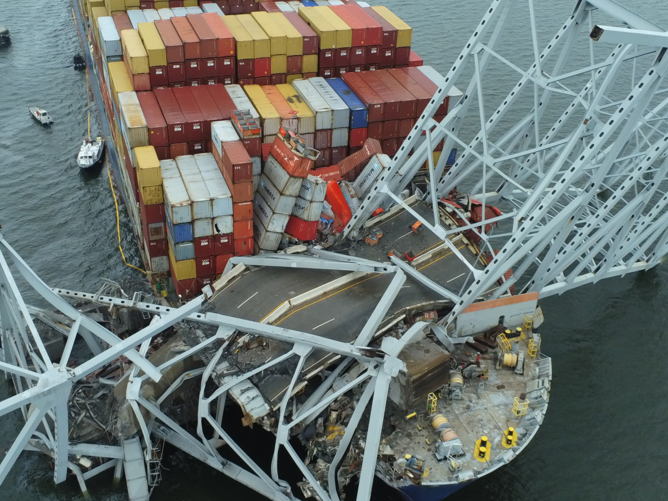
Motor Vessel Dali Electrical Distribution System Failure: Emergency and Critical Loads lost power
March 28, 2024
Baltimore MD
USCG Photo

Slide 5
Electric Power Load Analysis (EPLA)
Electric Load List
Lists all electric loads and their properties.
Identification and characterization of large loads is important
Large load have a rated load of more than 20% of the online power capacity in any operating condition.
Early on, undetermined loads may be modeled as “Proxy Loads.”
Proxy loads may represent a single load or a collection of loads.
Load Analysis
Determine the maximum operating load under various conditions.
Traditionally only applied at total ship level to determine required generator set capacity.
May be employed to determine required capacity of other power system equipment such as MV to LV transformers and power converters.
Some loads are temperature dependent.
Load Factor analysis is most common; DPC 310-1 defines alternate methods.
References
DPC 310-1
IEEE Std 45.1

Slide 6
Quality of Service - Introduction
Measure of continuity of service from the perspective of the load
Failure of continuity of service is a service interruption.
Metric is “mean time between service interruption” or MTBSI.
A service interruption is a disruption in power quality for a duration that that the load cannot tolerate.
If a load can tolerate a disruption of a given duration, then that disruption is not a service interruption.
Service interruptions categorized in terms of two system design variables:
Reconfiguration time (t1): maximum time to reconfigure the electrical distribution system or to clear faults without bring on additional generation capacity.
Generator start time (t2): maximum time to bring the slowest standby generator set online.
Technology choices impact t1 and t2.

Slide 7
Quality of Service – Load categorization
Un-interruptible Load
Cannot tolerate a power disruption of duration t1.
Power system should be designed to provide these loads with un-interruptible power.
Short-term interrupt Load
Can tolerate a power disruption of duration t1.
Cannot tolerate a power disruption of duration t2.
Power system should be designed to subject these loads to power disruptions of no more than t1 duration.
Long-term interrupt Load
Can tolerate a power disruption of duration t2.
Power system should be designed to subject these loads to power disruptions of no more than t2 duration.
Technology choices for power system components impact classification of loads

Slide 8
System Stability and Constant Power Loads
Loads with highly efficient power electronic converters at the interface to the power distribution system may exhibit a constant power load characteristic.
As the system voltage decreases, the load current increases: negative incremental resistance.
Negative incremental resistance can interact with controls of the power system components, filters, and parasitic capacitances and inductances to create a system instability.
The presences of constant power loads calls for conducting a system stability analysis to ensure overall system stability.
Controls may be modified to stabilize an otherwise unstable system.

Slide 9
Electrical power system – load control interface
Most loads do not directly communicate with the electrical power system controls.
These loads are called uncontrolled loads.
Only control mechanism for the electrical power system controls is to either provide power or turn power off.
Uncontrolled loads may be augmented with power system interface device (PSID) to provide connectivity between the load and the electrical power system controls.
Controlled loads have an interface between the electrical power system controls and the load.
A control interface facilitates load management, system stability, power continuity to emergency and mission critical loads, and survivability.

Slide 10
Survivability
Zonal Survivability
If any one or two adjacent zones are damaged, loads in undamaged zones do not experience a service interruption.
Requires ship to be designed zonally.
Compartment Survivability
Enables restoration of power to undamaged mission critical equipment within a damaged zone.
Typically implemented with normal and alternate power feeds through a bus transfer.
May include casualty power.

Slide 11
Survivability – Emergency Loads and Mission Critical Equipment
Commercial ships
Emergency loads defined in IEEE Std 45.1 and regulations.
Supplied power from an emergency power distribution system.
Includes emergency generator.
Includes connection to the normal power distribution system.
Naval ships
Emergency loads include those for commercial ships plus additional loads.
Often employ dual-use generators.
No separate emergency generator.
No separate emergency power distribution system.
Load shedding ensures emergency loads do not experience a service interruption.
Mission Critical Equipment (MCE) designated to remain operational during emergency conditions.
Emergency loads are a subset of MCE.

Slide 12
Mission Priority Load Shedding vs. Quality of Service Load Shedding.
Most load shedding schemes are purely mission priority load shedding.
Loads are prioritized by their contribution to the ship’s mission.
Emergency loads and MCE have the highest priority.
Loads with the lowest priority are shed first until generation capacity equals or exceeds load demand.
Quality of Service load shedding is an alternate method.
For power disruption durations that approach t1, Long-term interrupt loads are shed.
If power is restored by t2, which should be the norm, then these loads will not experience a service interruption – Goal is to minimize service interruptions.
If additional loads must be shed, then sufficient short-term interrupt loads are shed.
These loads will experience a service interruption.
Lower mission priority short-term interrupt loads should be shed first.
If the power disruption durations approaches t2, strategy switches to mission priority load shedding.
Service interruptions are likely – minimize their impact.
Higher priority loads that have been shed are restored.
Lower priority loads that have not been previously shed are now shed.

